Slide 1
Deadlock

Slide 2
A Deadlock is a situation where each of the computer process waits for a resource which is being assigned to some another process.
In this situation, none of the process gets executed since the resource it needs, is held by some other process which is also waiting for some other resource to be released.
In a computer system deadlocks arise when members of a group of processes which hold resources are blocked indefinitely from access to resources held by other processes within the group.

Slide 3
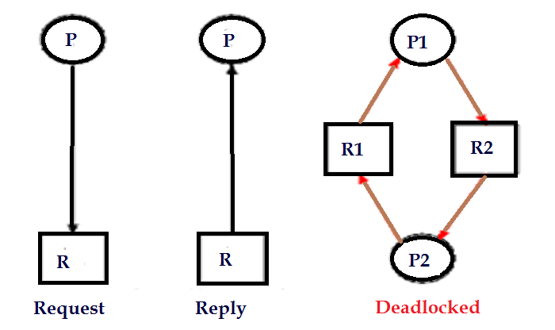
Deadlock Occurrence

Slide 4
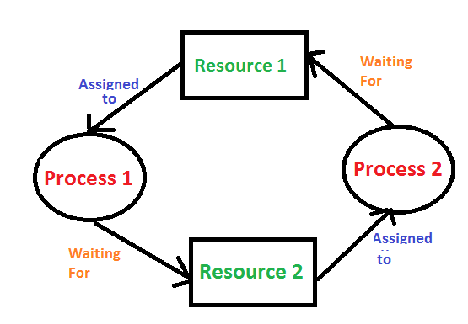

Slide 5
Simple Way Understand About Deadlock
Process1 requests resource A and receives it.
Process 2 requests resource B and receives it.
Process 1 requests resource B and is queued up, pending the release of B.
Process 2 requests resource A and is queued up, pending the release of A.

Slide 6

Deadlock Characterization
Deadlock Conditions
Systems Resource Allocation Graph
There are four conditions that are necessary to achieve deadlock:
1) Deadlock Conditions
i) Mutual Exclusion
In a multiprogramming environment, there may be several processes requesting the same resource at a time. The mutual exclusion condition, allow only a single process to access the resource at a time. While the other processes requesting the same resource must wait and delay their execution until it has been released. The mutual exclusion condition prevents two or more processes to access the same resource at a time.

Slide 7
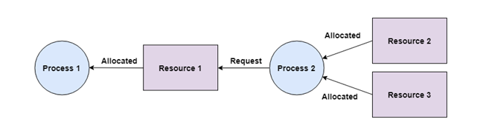
ii) Hold and wait
The hold and wait condition simply means that the process must be holding access to one resource and must be waiting to get hold of other resources that have been acquired by the other processes.

Slide 8
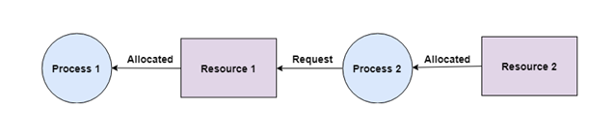
iii) No Preemption
A process acquiring a resource, cannot be preempted in between, to release the acquired resource. Instead, the process must voluntarily release the resource it has acquired when the task of the process has been completed.

Slide 9
iv) Circular Wait
The processes must be waiting in a circular pattern to acquire the resource. This is similar to hold and waits the only difference is that the processes are waiting in a circular pattern.

Slide 10
Let us discuss this with an example there are five processes i.e. P₀, P_{1,} P_{2,} P_{3,} P₄.
Now the process P₁ is waiting to acquire the process held by the P₂, further the process P₂ is waiting to acquire the resource held by P₃ resource held by P_{0.}

Slide 11
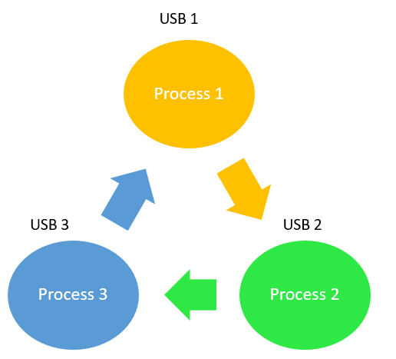
Example of Circular Wait

Slide 12
Q1) Which of the following condition is required for a deadlock to be possible?
a) Mutual exclusion
b) A process may hold allocated resources while awaiting assignment of other resources
c) No resource can be forcibly removed from a process holding it d) All of the mentioned

Slide 13
Q2) The circular wait condition can be prevented by :-
a) Defining a linear ordering of resource types b) Using thread c) Using pipes d) All of the mentioned

Slide 14
2) System Resource Allocation Graph
The system reallocation graph is a directed graph that briefs you about the deadlock more precisely. Like every graph, it also has a set of vertices and a set of edges. Further, the set of vertices can be classified into two types of nodes P and R.
Where P is the set of vertices indicating the set of active processes and R is the set of vertices indicating all types of resources in the system.
When a process requests for a resource it denoted by the request edge in the resource-allocation graph. The request edge is a directed edge from the requesting process P_{i} to requested resource R_{j} i.e. P_{i} -> R_{j}.

Slide 15
Well, when a resource is allotted to some process then it is denoted by the assignment edge. The assignment edge is the directed edge from the instance of resource R_{j} to the process P_{i} i.e. R_{j} -> P_{i}.
In the graph, resources are denoted by the rectangles and the processes are denoted by the circles. If a resource has multiple instances then it is denoted by the dots inside the rectangle.
When a process request for an instance of the resource it directs a request edge to the resource. If the resource is able to allocate the resource instance to the requesting process then immediately the request edge is converted to assignment edge.
The request edge always points to the resource rectangle in the graph, not to dots (instance) inside the rectangle. Although the assignment edge nominates the dot (instance) to a process.

Slide 16
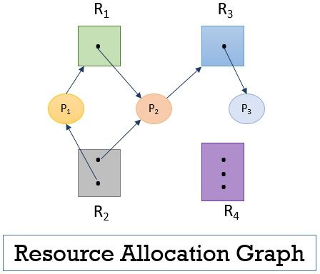
Resource Allocation Graph
Figure 1 Resource Allocation

Slide 17
To understand deadlock we let us take an example. Consider we have following set of nodes and edges.
There are three active processes P = {P₁, P₂, P₃}
There are four resources R = { R_{1,} R₂, R₃, R₄}
The set of request edge and assignment edges we have
E = { P1 -> R₁, P₂ -> R₃, R₁ -> P₂, R₂ -> P₂, R₂ -> P₁, R₃ -> P₃}
Observe the previous figure 1 above that the resource R₁ has only one instance, resource R₂ has two instances, resource R₃ has one instance, and resource R₄ has three instances. Let us check the status of the processes.

Slide 18
The previous figure1 shows that the process P₁ has requested for the instance of resource R₁ is already holding the instance of resource R₂.
The process P₂ has requested for the instance of resource R₃ and is already holding the instances of resource R₁ and R₃.
The process P₃ has not requested for any resource instance but is holding the instance for resource R₃.

Slide 19
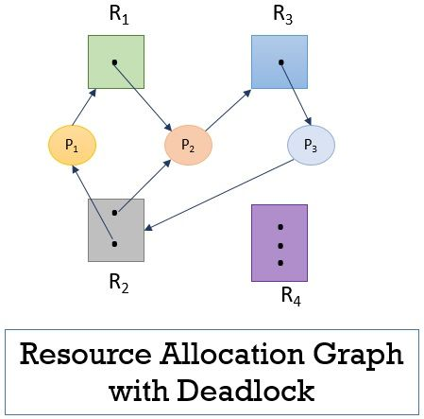
Resource Allocation with Deadlock
Figure 2 Resource Allocation with Deadlock
Process P₁, P₂ and P₃ are now in deadlock as each process in the cycle is waiting for the resource held by another process.
But every cycle in the resource allocation graph does not indicate the deadlock, you have to observe the cycle carefully while dealing with deadlock problem. So, this is how you can characterize the deadlock in the system.

Slide 20
Remember if the resource allocation graph has a cycle and every resource has a single instance then it implies that a deadlock has occurred. In case, the resources have multiple instances then a cycle in the graph need not be indicating the occurrence of deadlock.
Consider that the process P₃ is requesting for the instance of resource R₂ which is already held by the process P₁ and P₂. In this case, you will observe that there are two cycles in the resource allocation graph:
P₁ -> R ₁ -> P₂ -> R₃ -> P₃ -> R₂ -> P₁
P₂ -> R₃ -> P₃ -> R₂ -> P₂

Slide 21
Q1) If the wait for graph contains a cycle that means:
a) Then a deadlock does not exist
b) Then a deadlock exists
c) Then the system is in a safe state
d) Either deadlock exists or system is in a safe state

Slide 22
Q2) An edge from process Pi to Rj in a wait for graph indicates
a) Pi is waiting for Rj to release a resource that Pi needs b) Pj is waiting for Ri to release a resource that Pj needs c) Pi is waiting for Rj to leave the system d) Pj is waiting for Ri to leave the system

Slide 23
Handling of Deadlock
Deadlock Ignorance
Deadlock Prevention
Deadlock Avoidance
Deadlock Detection

Slide 24
Methods for Handling Deadlock
There are mainly four methods for handling deadlock.
1) Deadlock Ignorance
It is the most popular method and it acts as if no deadlock and the user will restart. As handling deadlock is expensive to be called of a lot of codes need to be altered which will decrease the performance so for less critical jobs deadlock are ignored.

Slide 25
2) Deadlock Prevention
It means that we design such a system where there is no chance of having a deadlock. (Eliminate the Conditions)
Mutual exclusion
At a time only one process allowed to share resource/s. It can’t be resolved as it is the hardware property. For example, the printer cannot be simultaneously shared by several processes. This is very difficult because some resources are not sharable.
Hold and wait
Hold and wait can be resolved using the conservative approach where a process can start it and only if it has obtained all the resources. The process will make a new request for resources after releasing the current set of resources. This solution may lead to starvation.
Active Approach
Here the process acquires only requires resources but whenever a new resource requires it must first release all the resources.

Slide 26
Wait time Out
Here there is a maximum time bound until which a process can wait for other resources after which it must release the resources.
Circular Wait
In order to remove circular wait, we assign a number to every resource and the process can request only in the increasing order otherwise the process must release all the high number acquires resources and then make a fresh request.
No preemption
In no preemption, we allow forceful preemption where a resource can be forcefully preempted. The preempted resource is added to the list of resources where the process is waiting. The new process can be restarted only when it regains its old resources. Priority must be given to a process which is in waiting for state.

Slide 27
3) Deadlock Avoidance
Here whenever a process enters into the system it must declare maximum demand. To the deadlock problem before the deadlock occurs. This approach employs an algorithm to access the possibility that deadlock would occur and not act accordingly. If the necessary condition of deadlock is in place it is still possible to avoid feedback by allocating resources carefully.
A deadlock avoidance algorithm dynamically examines the resources allocation state to ensure that a circular wait condition case never exists. Where the resources allocation state is defined by the available and allocated resources and the maximum demand of the process.

Slide 28
There are 3 states of the system:
Safe state
When a system can allocate the resources to the process in such a way so that they still avoid deadlock then the state is called safe state. When there is a safe sequence exit then we can say that the system is in the safe state.
A sequence is in the safe state only if there exists a safe sequence. A sequence of process P1, P2, Pn is a safe sequence for the current allocation state if for each Pi the resources request that Pi can still make can be satisfied by currently available resources pulls the resources held by all Pj with j<i.

Slide 29
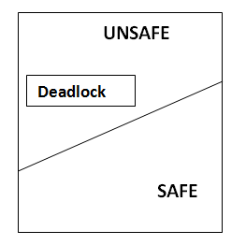

Slide 30
Methods for deadlock Avoidance
1) Resource Allocation Graph(RAG)
This graph is also kind of graphical bankers' algorithm where a process is denoted by a circle Pi and resources is denoted by a rectangle R1 and R2 inside the resources represents copies.
Presence of a cycle in the resources allocation graph is necessary but not sufficient condition for detection of deadlock. If the type of every resource has exactly one copy than the presence of cycle is necessary as well as sufficient condition for detection of deadlock.
Single instance of a resource type => Use a resource-allocation graph
Multiple instances of a resource type => Use the Banker’s algorithm

Slide 31
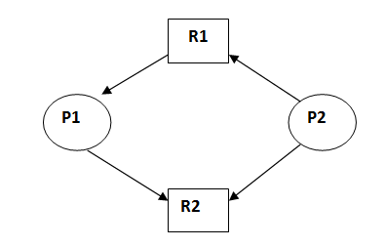
This is in unsafe state (cycle exist) if P1 request P2 and P2 request R1 then deadlock will occur.

Slide 32
Q1) For an effective operating system, when to check for deadlock?
a) Every time a resource request is made b) At fixed time intervals c) Every time a resource request is made at fixed time intervals d) None of the mentioned

Slide 33
Q2) If deadlocks occur frequently, the detection algorithm must be invoked:
a) Rarely b) Frequently c) Rarely & frequently d) None of the mentioned

Slide 34
2) Bankers’s Algorithm
Banker's Algorithm is used majorly in the banking system to avoid deadlock. It helps you to identify whether a loan will be given or not. Suppose there are n number of account holders in a bank and the total sum of their money is S.
If a person applies for a loan then the bank first subtracts the loan amount from the total money that bank has and if the remaining amount is greater than S then only the loan is sanctioned. It is done because if all the account holders comes to withdraw their money then the bank can easily do it.
Whenever a process requests some resources we first check whether the system is in a safe state or not, meaning if every process requires maximum resources then is there any sequence in which request can be entertaining if yes then request is allocated otherwise rejected.
Safety algorithm
This algorithm is used to find whether system is in safe state or not we can find
Remaining Need = Max Need – Current allocation

Slide 35
When the requested resource is allocated to the process by changing state:
Available = Available - Request Allocation(i) = Allocation(i) + Request (i)// i=0 or 1,2,3,4,5
Need_{i} = Need_{i} - Request_{i}
When the resource allocation state is safe, its resources are allocated to the process P(i). And if the new state is unsafe, the Process P (i) has to wait for each type of Request R(i) and restore the old resource-allocation state.

Slide 36
Consider a system that contains five processes P1, P2, P3, P4, P5 and the three resource types A, B and C. Following are the resources types:
A has 10,
B has 5
C has 7 instances.

Slide 37
Process | Allocation A B C | Max A B C | Available A B C
P1 | 0 1 0 | 7 5 3 | 3 3 2
P2 | 2 0 0 | 3 2 2
P3 | 3 0 2 | 9 0 2
P4 | 2 1 1 | 2 2 2
P5 | 0 0 2 | 4 3 3

Slide 38
Find out
What is the reference of the need matrix?
Determine if the system is safe or not.
What will happen if the resource request (1, 0, 2) for process P1, can the system accept this request immediately?

Slide 39
Ans. 1: Context of the need matrix is as follows:
Need [i] = Max [i] - Allocation [i]
Need for P1: (7, 5, 3) - (0, 1, 0) = 7, 4, 3 Need for P2: (3, 2, 2) - (2, 0, 0) = 1, 2, 5 Need for P3: (9, 0, 2) - (3, 0, 2) = 6, 0, 0 Need for P4: (2, 2, 2) - (2, 1, 1) = 0, 1, 1 Need for P5: (4, 3, 3) - (0, 0, 2) = 4, 3, 1

Slide 40
Process | Need A B C
P1 | 7 4 3
P2 | 1 2 2
P3 | 6 0 0
P4 | 0 1 1
P5 | 4 3 1
Available A B C
3 3 2

Slide 41
Hence, we created the context of need matrix.
Ans. 2: Apply the Banker's Algorithm:
Available Resources of A, B and C are 3, 3, and 2.
Now we check if each type of resource request is available for each process.

Slide 42
Step 1: For Process P1:
Need <= Available
7, 4, 3 <= 3, 3, 2 condition is false.
So, we examine another process, P2.
Step 2: For Process P2
Need <= Available
1, 2, 2 <= 3, 3, 2 condition true
New available = available + Allocation
(3, 3, 2) + (2, 0, 0) => 5, 3, 2 (Current Availability of Resources)
Similarly, we examine another process P3.

Slide 43
Step 3: For Process P3:
P3 Need <= Available
6, 0, 0 < = 5, 3, 2 condition is false.
Similarly, we examine another process, P4.
Step 4: For Process P4:
P4 Need <= Available
0, 1, 1 <= 5, 3, 2 condition is true
New Available resource = Available + Allocation
5, 3, 2 + 2, 1, 1 => 7, 4, 3
Similarly, we examine another process P5.

Slide 44
Step 5: For Process P5:
P5 Need <= Available
4, 3, 1 <= 7, 4, 3 condition is true
New available resource = Available + Allocation
7, 4, 3 + 0, 0, 2 => 7, 4, 5
Now, we again examine each type of resource request for processes P1 and P3.
Step 6: For Process P1:
P1 Need <= Available
7, 4, 3 <= 7, 4, 5 condition is true
New Available Resource = Available + Allocation
7, 4, 5 + 0, 1, 0 => 7, 5, 5
So, we examine another process P3.

Slide 45
Step 7: For Process P3:
P3 Need <= Available
6, 0, 0 <= 7, 5, 5 condition is true
New Available Resource = Available + Allocation
7, 5, 5 + 3, 0, 2 => 10, 5, 7
Hence, we execute the banker's algorithm to find the safe state and the safe sequence like P2, P4, P5, P1 and P3.
Ans. 3: For granting the Request (1, 0, 2), first we have to check that Request <= Available, that is (1, 0, 2) <= (3, 3, 2), since the condition is true. So the process P1 gets the request immediately.

Slide 46
Current available = Total avalable – Current allocation or Current Resources. Let's understand it by an example:
Consider the following 3 process total resources are given for A= 6, B= 5, C= 7, D = 6 // Available
Process | Maximum |  |  |  | Allocation |  |  |  | Need
 | A | B | C | D | A | B | C | D | A | B | C | D
P1 | 3 | 3 | 2 | 2 | 1 | 2 | 2 | 1 | 2 | 1 | 0 | 1
P2 | 1 | 2 | 3 | 4 | 1 | 0 | 3 | 3 | 0 | 2 | 0 | 1
P3 | 1 | 3 | 5 | 0 | 1 | 2 | 1 | 0 | 0 | 1 | 4 | 0
First we find the need matrix by Need= maximum – allocation
Then find available resources = total – allocated
A B C D( 6 5 7 6) - A B C D( 3 4 6 4)= Available resources A B C D( 3 1 1 2) + (1+2+2+1)= (4 3 3 3) + (1 0 3 3)= (5 3 6 6) + (1 2 1 0)=6 5 7 6

Slide 47
Q1) Which one of the following is the deadlock avoidance algorithm?
a) Banker’s algorithm b) Round-robin algorithm c) Elevator algorithm d) Karn’s algorithm

Slide 48
Q2) A state is safe, if
a) The system does not crash due to deadlock occurrence
b) The system can allocate resources to each process in some order and still avoid a deadlock
c) The state keeps the system protected and safe
d) All of the mentioned

Slide 49
Allocation |  |  |  | Max |  |  | Need
 | X | Y | Z | X | Y | Z | X | Y | Z
P0 | 3 | 0 | 2 | 11 | 8 | 3 | 8 | 8 | 1
P1 | 3 | 4 | 0 | 6 | 7 | 1 | 0 | 0 | 0
P2 | 2 | 1 | 1 | 2 | 3 | 11 | 0 | 2 | 10
There are 5 units of resource X , 4 units of type Y and 6 units of type Z still available.
Consider the following independent requests for additional resources in the current state. Confirm that system will be in a safe or unsafe state.
(X,Y,Z)=(5,4,6)+(3,4,0)=(8,8,6)+(3,0,2)=11,8,8

Slide 50
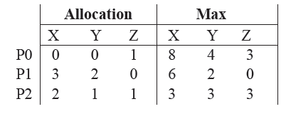
Q1) An operating system uses the Banker's algorithm for deadlock avoidance when managing the allocation of three resource types X,Y, and Z to three processes P0,P1, and P2. The table given below presents the current system state.
Here, the Allocation matrix shows the current number of resources of each type allocated to each process and the Max matrix shows the maximum number of resources of each type required by each process during its execution.

Slide 51
REQ1: P0 requests 0 units of X, 0 units of Y and 2 units of Z
REQ2: P1 requests 2 units of X, 0 units of Y and 0 units of Z
Which one of the following is TRUE?
Only REQ1 can be permitted.
Only REQ2 can be permitted.
Both REQ1 and REQ2 can be permitted.
Neither REQ1 nor REQ2 can be permitted.

Slide 52
Deadlock Detection
Deadlock Detection Algorithm helps decide if in scenario of multi instance resources for various processes are in deadlock or not.
If deadlocks are not avoided, then another approach is to detect when they have occurred and recover some how.
In addition to the performance hit of constantly checking for deadlocks, a policy / algorithm must be in place for recovering from deadlocks, and there is potential for lost work when processes must be aborted or have their resources preempted.
In cases of single resource instance we can create wait-for graph to check deadlock state. But, this we can’t do for multi instance resources system.
Allow system to enter deadlock state
Detection algorithm
Recovery scheme

Slide 53
Single Instance of Each Resource Type
Maintain wait-for graph » Nodes are processes » Pi → Pj if Pi is waiting for Pj
Periodically invoke an algorithm that searches for a cycle in the graph. If there is a cycle, there exists a deadlock
An algorithm to detect a cycle in a graph, where n is the number of vertices in the graph

Slide 54
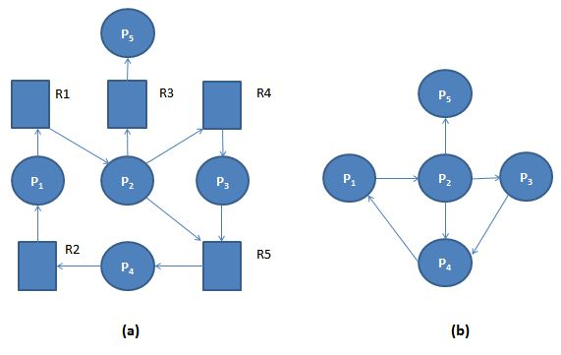
Example: (a). 'Resource-Allocation Graph' and Corresponding (b). 'Wait-for Graph'

Slide 55
Several Instances of a Resource Type
Available: A vector of length m indicates the number of available resources of each type.
Allocation: An n x m matrix defines the number of resources of each type currently allocated to each process.
Request: An n x m matrix indicates the current request of each process. If Request [i][j] = k, then process Pi is requesting k more instances of resource type Rj.

Slide 56
1. Let Work and Finish be vectors of length m and n, respectively Initialize:
(a) Work = Available
(b) For i = 1,2, …, n, if Allocation ≠ 0, then Finish[i] = false; otherwise, Finish[i] = true
2. Find an index i such that both:
(a) Finish[i] == false
(b) Request ≤ Work If no such i exists, go to step 4
3. Work = Work + Allocation, Finish[i] = true go to step 2
4. If Finish[i] == false, for some i, 1 ≤ i ≤ n, then the system is in deadlock state.
Moreover, if Finish[i] == false, then Pi is deadlocked

Slide 57
Five processes P0 through P4; three resource types A (7 instances), B (2 instances), and C (6 instances)
Snapshot at time T0: (free resources= (0 1 0)+(303)+(211)= 5 2 4
 | Allocation | Request | Available
Process | A B C | A B C | A B C
P0(execute) | 0 1 0 | 0 0 0 | 0 0 0
P1(execute) | 2 0 0 | 2 0 2
P2(execute) | 3 0 3 | 0 0 0
P3(execute) | 2 1 1 | 1 0 0
P4(execute) | 0 0 2 | 0 0 2

Slide 58
Sequence <P0, P2, P3, P1, P4> will result in Finish[i] = true for all I
P2 requests an additional instance of type C
 | Request
Process | A B C
P1 | 2 0 0
P2 | 3 0 3
P3 | 2 1 1
P4 | 0 0 2
State of system?
Can reclaim resources held by process P0, but insufficient resources to fulfill other processes; requests
Deadlock exists, consisting of processes P1, P2, P3, and P4

Slide 59
Detection-Algorithm Usage
When, and how often, to invoke depends on:
How often a deadlock is likely to occur?
How many processes will need to be rolled back? one for each disjoint cycle?
If detection algorithm is invoked arbitrarily, there may be many cycles in the resource graph and so we would not be able to tell which of the many deadlocked processes “caused” the deadlock.

Slide 60
4) Detection and Recovery
When the system is in deadlock then one method is to inform the operates and then operator deal with deadlock manually and the second method is system will automatically recover from the deadlock. There are two ways to recover from deadlock.
Process termination
Deadlock can be eliminated by aborting a process. Abort all deadlock process. Abort is processed at a time until the deadlock cycle is eliminated. This can help to recover the system from file deadlock.
Resources preemption
To eliminate deadlock using resources preemption, we prompt the same resources pass processes and give these resources to another process until the deadlock cycle is broken. Here a process is partially rollback until the last checkpoint or and hence detection algorithm is executed.

Slide 61
When a detection algorithm determines that a deadlock exists, several alternatives are available.
One possibility is to inform the operator that a deadlock has occurred and to let the operator deal with the deadlock manually.
Another possibility is to let the system recover from the deadlock automatically.
There are two options for breaking a deadlock.
One is simply to abort one or more processes to break the circular wait.
The other is to preempt some resources from one or more of the deadlocked processes.

Slide 62
Abort one process at a time until the deadlock cycle is eliminated.
This method incurs considerable overhead, since, after each process is aborted, a deadlock-detection algorithm must be invoked to determine whether any processes are still deadlocked. Aborting a process may not be easy. If the process was in the midst of updating a file, terminating it will leave that file in an incorrect state.

Slide 63
2) Resource Preemption
To eliminate deadlocks using resource preemption, we successively preempt some resources from processes and give these resources to other processes until the deadlock cycle is broken. If preemption is required to deal with deadlocks, then three issues need to be addressed:
1) Selecting a victim.
Which resources and which processes are to be preempted? As in process termination, we must determine the order of preemption to minimize cost. Cost factors may include such parameters as the number of resources a deadlocked process is holding and the amount of time the process has thus far consumed during its execution.
2) Rollback.
If we preempt a resource from a process, what should be done with that process? Clearly, it cannot continue with its normal execution; it is missing some needed resource. We must roll back the process to some safe state and restart it from that state.

Slide 64
Since, in general, it is difficult to determine what a safe state is, the simplest solution is a total rollback:
Abort the process and then restart it. Although it is more effective to roll back the process only as far as necessary to break the deadlock, this method requires the system to keep more information about the state of all running processes.
3) Starvation.
How do we ensure that starvation will not occur? That is, how can we guarantee that resources will not always be preempted from the same process? In a system where victim selection is based primarily on cost factors, it may happen that the same process is always picked as a victim.
As a result, this process never completes its designated task, a starvation situation that must be dealt with in any practical system. Clearly, we must ensure that a process can be picked as a victim only a (small) finite number of times. The most common solution is to include the number of rollbacks in the cost factor.

Slide 65
Q1) The wait-for-graph is a deadlock detection algorithm that is applicable when
a)All resources have a single instance b)All resources have multiple instances c)All resources have a single 7 multiple instances
d) All of the mentioned

Slide 66
Q2) What is the disadvantage of invoking the detection algorithm for every request?
a) Overhead of the detection algorithm due to consumption of memory b) Excessive time consumed in the request to be allocated memory c) Considerable overhead in computation time d) All of the mentioned

Slide 67
Q3) Each request requires that the system consider the _____________ to decide whether the current request can be satisfied or must wait to avoid a future possible deadlock.
a)Resources currently available
b)Processes that have previously been in the system
c) Resources currently allocated to each process d) Future requests and releases of each process

Slide 68
File Management
File management is one of the basic and important features of operating system.
Operating system is used to manage files of computer system. All the files with different extensions are managed by operating system.
A file is collection of specific information stored in the memory of computer system.
File management is defined as the process of manipulating files in computer system, it management includes the process of creating, modifying and deleting the files.

Slide 69
The following are some of the tasks performed by file management of operating system of any computer system:
It helps to create new files in computer system and placing them at the specific locations.
It helps in easily and quickly locating these files in computer system.
It makes the process of sharing of the files among different users very easy and user friendly.
It helps to stores the files in separate folders known as directories. These directories help users to search file quickly or to manage the files according to their types or uses.
It helps the user to modify the data of files or to modify the name of the file in the directories.

Slide 70
File System
Data collections created by users .The File System is one of the most important parts of the OS to a user. Desirable properties of files:
Long-term existence
Files are stored on disk or other secondary storage and do not disappear when a user logs off
Sharable between processes
Files have names and can have associated access permissions that permit controlled sharing
Structure
Files can be organized into hierarchical or more complex structure to reflect the relationships among files.

Slide 71
File Systems
Provide a means to store data organized as files as well as a collection of functions that can be performed on files.
Maintain a set of attributes associated with the file.
Typical operations include:
Create
Delete
Open
Close
Read
Write

Slide 72
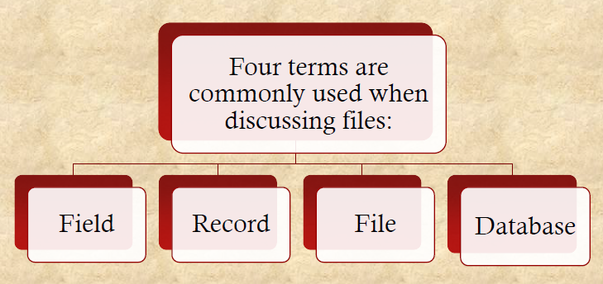
File Structure

Slide 73
Structure Terms
Field
Basic element of data.
Contains a single value.
Fixed or variable length.
Record
Collection of related fields that can be treated as a unit by some application program.
Fixed or variable length.
Database
Collection of related data.
Relationships among elements of data are explicit.
Designed for use by a number of different applications.
Consists of one or more types of files .
File
Collection of similar records.
Treated as a single entity.
May be referenced by name .
Access control restrictions usually apply at the file level.

Slide 74
File Management System Objectives
Meet the data management needs of the user.
Guarantee that the data in the file are valid .
Optimize performance.
Provide I/O support for a variety of storage device types.
Minimize the potential for lost or destroyed data.
Provide a standardized set of I/O interface routines to user processes.
Provide I/O support for multiple users in the case of multiple-user systems.

Slide 75
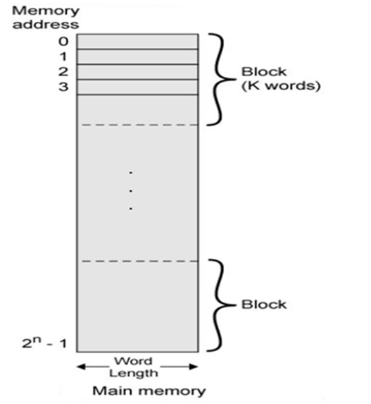
Main Memory Block Structure
int a=200
In hard disk Tracks
Sectors

Slide 76
Minimal User Requirements
The requirement of each user:
Should be able to create, delete, read, write and modify files.
May have controlled access to other users’ files .
May control what type of accesses are allowed to the files.
Should be able to restructure the files in a form appropriate to the problem.
Should be able to move data between files.
Should be able to back up and recover files in case of damage.
Should be able to access his or her files by name rather than by numeric identifier.

Slide 77
Basic File System
Also referred to as the physical I/O level.
Primary interface with the environment outside the computer system.
Deals with blocks of data that are exchanged with disk or tape systems.
Concerned with the placement of blocks on the secondary storage device.
Concerned with buffering blocks in main memory.
Considered part of the operating system.

Slide 78
File Attributes
Name – only information kept in human-readable form, For the convenience of human users.
Identifier – unique tag (number) identifies file within file system
Type – needed for systems that support different types
Location – Pointer to a device and the file location on the device.
Size – current file size
Protection – controls who can do reading, writing, executing.
Usage: – Usage means the time of creation, modification, and access, etc.
Mounting: – Mounting means if the root of a file system is grafted into the existing tree of other file systems.
Time, date, and user identification – data for protection, security, and usage monitoring Information about files are kept in the directory structure, which is maintained on the disk
Usually, a directory entry consists of a filename and its ID. The
ID locates the other attributes.

Slide 79
Q1) To create a file in system:-
a) Allocate the space in file system b) Make an entry for new file in directory c) Allocate the space in file system & make an entry for new file in directory d) None of the mentioned

Slide 80
Q2) File type can be represented by :
a) File name b) File extension c) File identifier d) None of the mentioned

Slide 81
Q3) By using the specific system call, we can do:
a) Open the file b) Read the file c) Write into the file d) All of the mentioned

Slide 82
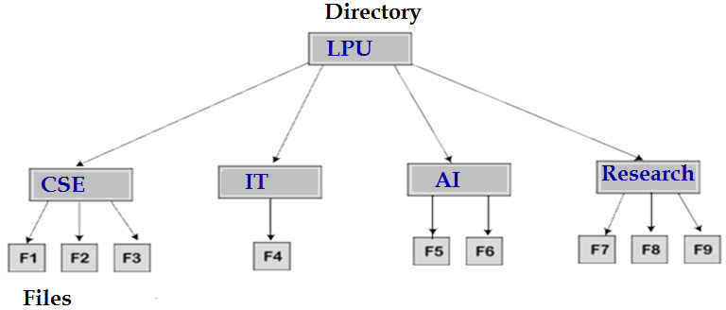
Directory Structure
A Directory is the collection of the correlated files on the disk. In simple words, a directory is like a container which contains file and folder. In a directory, we can store the complete file attributes or some attributes of the file. A directory can be comprised of various files. With the help of the directory, we can maintain the information related to the files.

Slide 83
To take the advantages of various file systems on the different operating systems, we can divide the hard disk into multiple partitions, which are of different sizes. Partitions are known as minidisks (tracks) or volumes (Sectors)
There should be at least one directory that must be present in each partition. Through it, we can list all the files of the partition. In the directory for each file, there is a directory entry, which is maintained, and in that directory entry, all the information related to the file is stored.

Slide 84
Operations on Directory
The various types of operations on the directory are:
Creating
Deleting
Searching
List a directory
Renaming
Link
Unlink
1) Creating
In this operation, a directory is created. The name of the directory
should be unique.
2) Deleting
If there is a file that we don’t need, then we can delete that file from the directory. We can also remove the whole directory if the directory is not required. An empty directory can also be deleted. An empty directory is a directory that only consists of dot and dot-dot.
3) Searching
Searching operation means, for a specific file or another directory, we can search a directory.

Slide 85
4) List a directory
List of all the files in the directory can be retrieved and also the contents of the directory entry, for each file in a list. To read the list of all the files in the directory, it must be opened and after reading the directory must be closed to free up the internal table space.
5) Renaming
The name of the file or a directory represents the content it holds and its use. The file or directory can be renamed in case, the content inside or the use of file get changed. Renaming the file or directory also changes its position inside the directory.
6) Link
The file can be allowed to appear in more than one directory. Here, the system call creates a link between the file and the name specified by the path where the file is to appear.
7) Unlink
If the file is unlinked and is only present in one directory its directory entry is removed. If the file appears in multiple directories, only the link is removed.

Slide 86
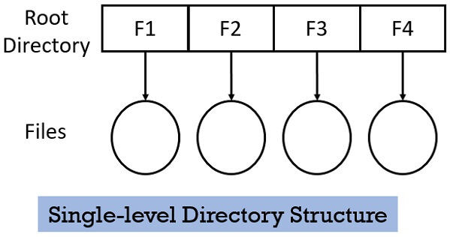
Types of Directory Structures
In this section, we will be discussing the most common types of directories, their benefits and drawbacks.
Single level directory structure has only one directory which is called the root directory. The users are not allowed to create subdirectories under the root directory. All the files created by the several users are present in the root directory only.
As you can see in the diagram below all the file F1, F2, F3, F4 created by the different users are present at the root directory.

Slide 87
Advantages and Disadvantages
Advantages of Single-Level Directory
The implementation of a single-level directory is so easy.
In a single-level directory, if all the files have a small size, then due to this, the searching of the files will be easy.
In a single-Level directory, the operations such as searching, creation, deletion, and updating can be performed.
Disadvantages of Single-Level Directory
If the size of the directory is large in Single-Level Directory, then the searching will be tough.
In a single-level directory, we cannot group the similar type of files.
The task of choosing the unique file name is a little bit complex.

Slide 88
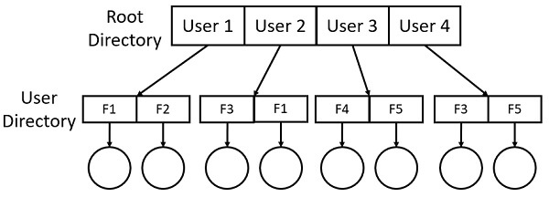
Two-level directory structure
In Two-level directory structure, the users create directory directly inside the root directory. But once a user creates such directory, further he cannot create any subdirectory inside that directory. Observe the figure below, 4 users have created their separate directory inside the root directory. But further, no subdirectory is created by the users.

Slide 89
Advantages and Disadvantages
Advantages of Two-Level Directory
In the two-level directory, various users have the same file name and also directory name.
Because of using the user-grouping and pathname, searching of files are quite easy.
Disadvantages of Two-Level Directory
In a two-level directory, one user cannot share the file with another user.
Another disadvantage with the two-level directory is it is not scalable.

Slide 90
Tree Directory Structure
In a tree directory structure, except root directory, every directory or file has only one parent directory. So, there is a total separation between the users which provide complete naming freedom. Here, if a user wishes to access another users file, it has to go through two or more directories.
The tree directory structure provides an asymmetric way for the user to access the shared files of a different user. For example, a user can access a file of its own user directory with a shorter path than the other user.
A path is either absolute and relative . An absolute path always contains the root element and the complete directory list required to locate the file.
For example, LPU/home/CSE/students is an absolute path. All of the information needed to locate the file is contained in the path string.
A relative path needs to be combined with another path in order to access a file. For example, CSE/Students is a relative path. Without more information, a program cannot reliably locate the CSE/Students directory in the file system.

Slide 91
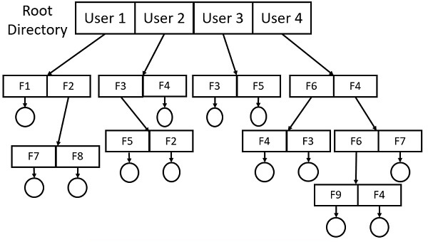
Tree Directory Structure

Slide 92
Advantages and Disadvantages
Advantages of tree-structured directory
The tree-structured directory is very scalable.
In the tree-structures directory, the chances of collision are less.
In the tree-structure directory, the searching is quite easy because, in this, we can use both types of paths, which are the absolute path and relative path.
Disadvantages of Tree-Structure Directory
In the tree-structure directory, the files cannot be shared.
Tree-structure directory is not efficient because, in this, if we want to access a file, then it may go under multiple directories.
Another disadvantage of the tree-structure directory is that each file does not fit into the hierarchal model. We have to save the files into various directories.

Slide 93
Acyclic-Graph Directory Structure
This problem can be solved by the acyclic-graph directory structure. As this directory structure allows a directory or a file to have many parent directories. So, a shared file in a directory can be pointed by the other user directories who have access to that shared file using the links.
In the diagram below you can see that the directory having file F7 and F8 have two parent directories.

Slide 94
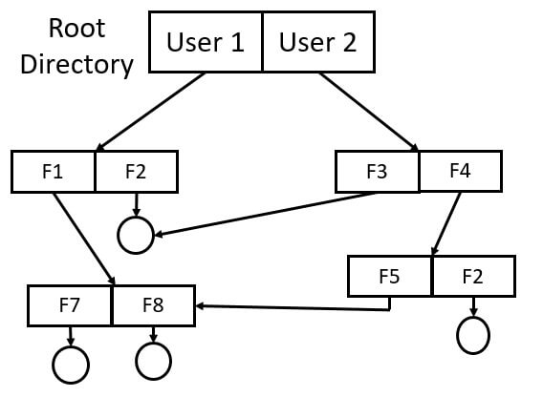
Acyclic-Graph Directory Structure

Slide 95
Advantages and Disadvantages
Advantages of Acyclic-Graph Directory
In the acyclic-graph directory, the sharing of files is possible.
In the acyclic-graph directory, because of different-different paths, searching is easy.
Disadvantages of Acyclic-Graph Directory
If the files are shared through linking, there may be a problem in the case of deleting.
If we are using softlink, then in this case, if the file is deleted then there is only a dangling pointer which is left.
If we are using hardlink, in this case, when we delete a file, then we also have to remove all the reference connected with it.

Slide 96
General Graph Directory Structure
In general graph directory structure, cycles are allowed within a directory structure where multiple directories can be derived from more than one parent directory.
The main problem with this kind of directory structure is to calculate total size or space that have been taken by the files and directories.

Slide 97
General Graph Directory Structure

Slide 98
Advantages and Disadvantages
Advantages
It allows cycles.
It is more flexible than other directories structure.
Disadvantages
It is more costly than others.
It needs garbage collection.

Slide 99
Directory Implementation
There are various types of algorithm which we use for directory implementation. The selection of a suitable algorithm for directory implementation is an essential task because it directly affects system performance.
We can classify the directory implementation algorithm based on the data structure. Mostly, we use two types of algorithms:
Linear List
Hash Table

Slide 100
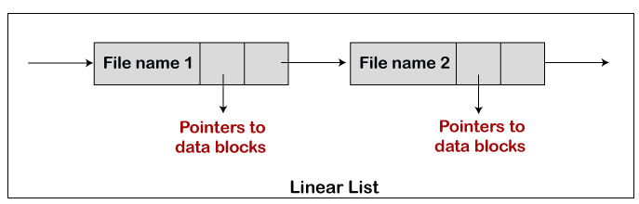
Linear List: – The linear list is the most straightforward algorithm which is used for directory implementation. In this algorithm, we keep all the files in a directory like a singly linked list. Every file comprises of a pointer to the data blocks that are allocated to it and the next file in the directory.

Slide 101
Hash Table– There are some disadvantages in singly linked implementation of directories. So, to remove this drawback, we use another method that is called a hash table. In this method, the hash table is used with the linked list.
In a directory, for every file, there is a key-value pair that is generated, and when the key-value pair is generated, then we store it into the hash table. With the help of the hash function on the file name, we can determine the key and key points to the respective file that are stored in a directory.

Slide 102
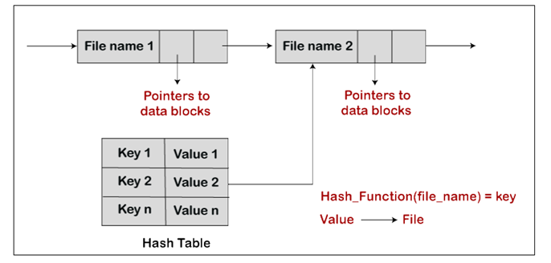
In a linear list, the task of searching is difficult because, in a linear list, we have to search the entire list, but in hash table approach, there is no requirement of searching the entire list. So, in hash table searching is quite efficient. With the help of the key, we only have to check the entries of the hash table, and when we get the entry, then by using the value, we will fetch the corresponding file.

Slide 103
Q1) What is true about Ordinary files?
These are the files that contain user information.
These files contain list of file names and other information related to these files.
These files represent physical device like disks, terminals, printers, networks, tape drive etc.
All of the above

Slide 104
Q2) What is true about Directory files?
These files represent physical device like disks, terminals, printers, networks, tape drive etc.
These may have text, databases or executable program.
These files contain list of file names and other information related to these files.
All of the above

Slide 105
File Implementation
Allocation Methods
Disk blocks must be allocated to files. The main problem is how to allocate space to files so that disk space is utilized effectively and files can be accessed quickly.
keeping track of which disk blocks go with which file
There are three major methods of allocating disk space to files:
Contiguous allocation
Linked allocation or Non-Contiguous allocation
Indexed allocation

Slide 106
Problem of Internal fragmentation and External fragmentation
Internal fragmentation happens when the method or process is larger than the memory. It occurs when memory is divided into fixed sized partitions.
Total space = 10GB divide in 5 Blocks ( each block store about max 1.5 GB) [1 block = 1.5 GB, 0.5 GB free ] 2.5 GB free space
External fragmentation occurs when memory is divided into variable size partitions based on the size of processes.

Slide 107
Contiguous Allocation
In this scheme, a file is made from the contiguous set of blocks on the disk. Linear ordering on the disk is defined by the disk addresses. In this scheme only one job is accessing the disk block b after that it accesses the block b+1 and there are no head movements.
When the movement of the head is needed the head moves only from one track to another track. So the disk number that is required for accessing the contiguous allocation is minimal.
For example, if a file requires n blocks and is given a block b as the starting location, then the blocks assigned to the file will be:
b, b+1, b+2,..., b+n-1.
This means that given the starting block address and the length of the file (in terms of blocks required), we can determine the blocks occupied by the file. For a contiguous allocation the directory entry the address of the starting block and Length of the allocated portion.

Slide 108
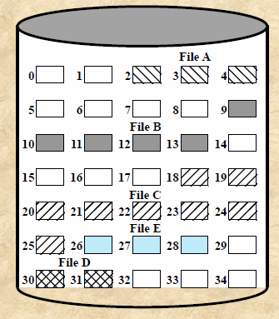
Contiguous Allocation
File Name | Start Block | Length
A | 2 | 3
B | 9 | 5
C | 18 | 8
D | 30 | 2
E | 26 | 3

Slide 109
Advantages and Disadvantages
Advantages:
In the contiguous allocation, sequential and direct access both are supported.
For the direct access, the starting address of the kth block is given and further blocks are obtained by b+K,
This is very fast and the number of seeks is minimal in the contiguous allocation method.
Disadvantages:
Contiguous allocation method suffers internal as well as external fragmentation.
In terms of memory utilization, this method is inefficient. Fragmentation Problem.
It is difficult to increase the file size because it depends on the availability of contiguous memory.

Slide 110
Linked Allocation
The problems of contiguous allocation are solved in the linked allocation method. In this scheme, disk blocks are arranged in the linked list form which is not contiguous.
The disk block is scattered in the disk. In this scheme, the directory entry contains the pointer of the first block and pointer of the ending block. These pointers are not for the users.
For example, a file of six blocks starts at block 10 and end at the block. Each pointer contains the address of the next block. When we create a new file we simply create a new entry with the linked allocation.
Each directory contains the pointer to the first disk block of the file. when the pointer is nil then it defines the empty file.

Slide 111
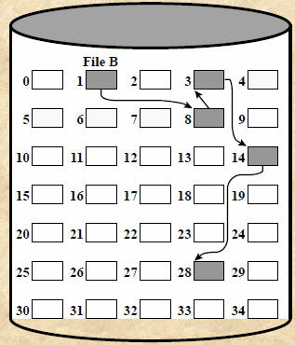
Linked Allocation
File Name | Start Block | Length
A | --- | ---
B | 1 | 5
C | --- | ----
D | ---- | ----
E | ---- | ----

Slide 112
Advantages and Disadvantages
Advantages:
In terms of the file size, this scheme is very flexible.
We can easily increase or decrease the file size and system does not worry about the contiguous chunks of memory.
This method free from external fragmentation this makes it better in terms of memory utilization.
Disadvantages:
In this scheme, there is large no of seeks because the file blocks are randomly distributed on disk.
Linked allocation is comparatively slower than contiguous allocation.
Random or direct access is not supported by this scheme we cannot access the blocks directly.
The pointer is extra overhead on the system due to the linked list.

Slide 113
Indexed Allocation
In this scheme, a special block known as the index block contains the pointer to all the blocks occupied by a file. each file contains its index which is in the form of an array of disk block addresses. The ith entry of index block point to the ith block of the file.
The address of the index block is maintained by the directory. When we create a file all pointer is set to nil. A block is obtained from the free space manager when the first ith block is written.
When the index block is very small it is difficult to hold all the pointers for the large file. to deal with this issue a mechanism is available. Mechanism includes the following:

Slide 114
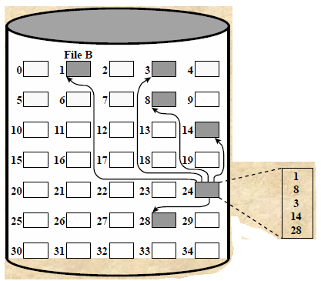
Indexed Allocation with Block Portions File
File Name | Index Block | Contains
A | --- | 1
B | 24 | 8
C | --- | 3
D | ---- | 14
E | ---- | 28

Slide 115
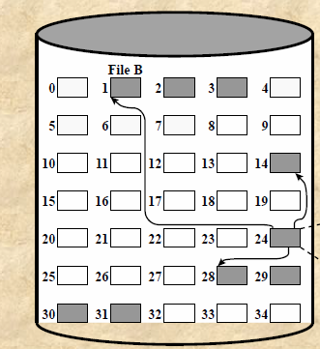
Indexed Allocation with Variable-Length Portions File
File Name | Index Block
A | ---
B | 24
C | ---
Start Block | Length
1 | 3
28 | 4
14 | 1

Slide 116
Advantages and Disadvantages
Advantages:
This scheme supports random access of the file.
This scheme provides fast access to the file blocks.
This scheme is free from the problem of external fragmentation.
Disadvantages:
The pointer head is relatively greater than the linked allocation of the file.
Indexed allocation suffers from the wasted space.
For the large size file, it is very difficult for single index block to hold all the pointers.
For very small files say files that expend only 2-3 blocks the indexed allocation would keep on the entire block for the pointers which is insufficient in terms of memory utilization.

Slide 117
Q1) In Space Allocation, Which of the following ways are correct to allocate disk space to files?
Contiguous Allocation
Linked Allocation
Indexed Allocation
All of the above

Slide 118
Q2) When will file system fragmentation occur?
a) Unused space or single file are not contiguous b) Used space is not contiguous c) Unused space is non-contiguous d) Multiple files are non-contiguous

Slide 119
Q3) What is the real disadvantage of a linear list of directory entries?
Size of the linear list in memory
Linear search to find a file
It is not reliable
All of the above

Slide 120
Free-Space Management
Just as allocated space must be managed, so must the unallocated space.
To perform file allocation, it is necessary to know which blocks are available.
A disk allocation table is needed in addition to a file allocation table.
The process of looking after and managing the free blocks of the disk is called free space management. There are some methods or techniques to implement a free space list. These are as follows:
Bitmap
Linked list
Grouping
Counting

Slide 121
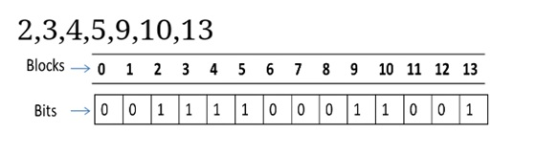
Bitmap or Bit Tables or BitVector
This method uses a vector containing one bit for each block on the disk.
Each entry of a 0 corresponds to a free block, and each 1 corresponds to a block in use. Assume the following are free. Rest are allocated:
Advantages:
Simple to understand.
Finding the first free block is efficient. It requires scanning the words (a group of bits or 8bit = 1 byte or 2byte = one word ) in a bitmap for a non-zero word. (A 0-valued word has all bits 0). The first free block is then found by scanning for the first 1 bit in the non-zero word.

Slide 122
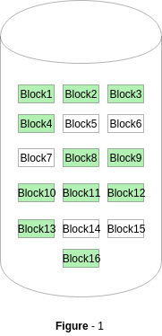
0 0 0
0 1 1
3 *1+1=4
Block Number Calculation= (No. of Bits per word)*(Number of 0 value words) + offset of first bit

Slide 123

Linked list
In this, there is a head pointer which points the first free block of the list which is kept in a special location on the disk. This block contains the pointer to the next block and the next block contain the pointer of another next and this process is repeated. By using this disk it is not easy to search the free list. This technique is not sufficient to traverse the list because we have to read each disk block that requires I/O time. So traversing in the free list is not a frequent action.
In example, we see that keep block 2 is the first free block which points to another block which contains the pointer of the 3 blocks and 3 blocks contain the pointer to the 4 blocks and this contains the pointer to the 5 block then 5 block contains the pointer to the next block and this process is repeated at the last .

Slide 124
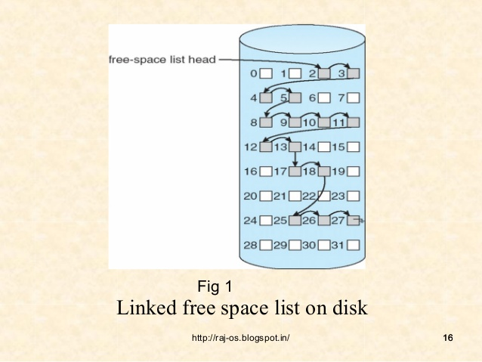

Slide 125
Advantages:
Whenever a file is to be allocated a free block, the operating system can simply allocate the first block in free space list and move the head pointer to the next free block in the list.
Disadvantages:
Searching the free space list will be very time consuming; each block will have to be read from the disk, which is read very slowly as compared to the main memory.
Not Efficient for faster access.

Slide 126
Indexing or Grouping
This is also the technique of free space management. In this, there is a modification of the free-list approach which stores the address of the n free blocks.
In this the first n-1 blocks are free but the first or block contains the address of the n blocks. When we use the standard linked list approach the addresses of a large number of blocks can be found very quickly.
In this approach, we cannot keep a list of n free disk addresses but we keep the address of the first free block.
An advantage of this approach is that the addresses of a group of free disk blocks can be found easily.

Slide 127
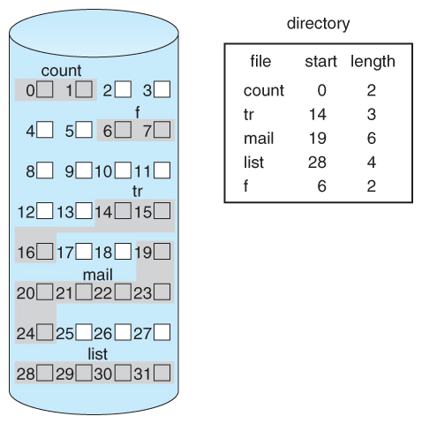
Blocks 2 has store the address of rest of the blocks
2 store the address of 3,4,5,8,9,10,11,12,1317,18,

Slide 128
Counting
Counting is another approach for free space management. Generally, some contiguous blocks are allocated but some are free simultaneously. When the free space is allocated to a process according to the contiguous allocation algorithm .
So we cannot keep the list of n free block address but we can keep the address of the first free block and then the numbers of n free contiguous block which follows the first block.

Slide 129
Counting
Allocated Space
Free Space Space
Block Point | No. of Blocks | Size
2 | 3,3,5 | 3
8 | 9,10,11,12,13 | 5
17 | 18 | 1
25 | 26,27 | 2

Slide 130
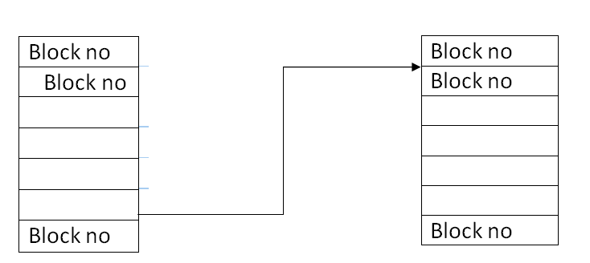
When there is an entry in the free space list it consists the address of the disk and a count variable. This method of free space management is similar to the method of allocating blocks.
We can store these entries in the B-tree in place of the linked list. So the operations like lookup, deletion, insertion are efficient.

Slide 131
Volumes
A collection of addressable sectors in secondary memory that an OS or application can use for data storage.
The sectors in a volume need not be consecutive on a physical storage device.
They need only appear that way to the OS or application.
A volume may be the result of assembling and merging smaller volumes.

Slide 132
Windows File System
The developers of Windows NT designed a new file system, the New Technology File System (NTFS) which is intended to meet high-end requirements for workstations and servers.
Key features of NTFS:-
Recoverability
Security
Large disks and large files
Multiple data streams
Journaling
Compression and encryption
Hard and symbolic links

Slide 133
Q1) If the block of Bit vector and free-space list is free then bit will:-
a)1 and 0
b) 0 and 1
c) Any of 0 or 1
d) None of the mentioned

Slide 134
Q2) The data structure used for file directory is called:
a) Mount table b) Hash table c) File table d) Process table

Slide 135
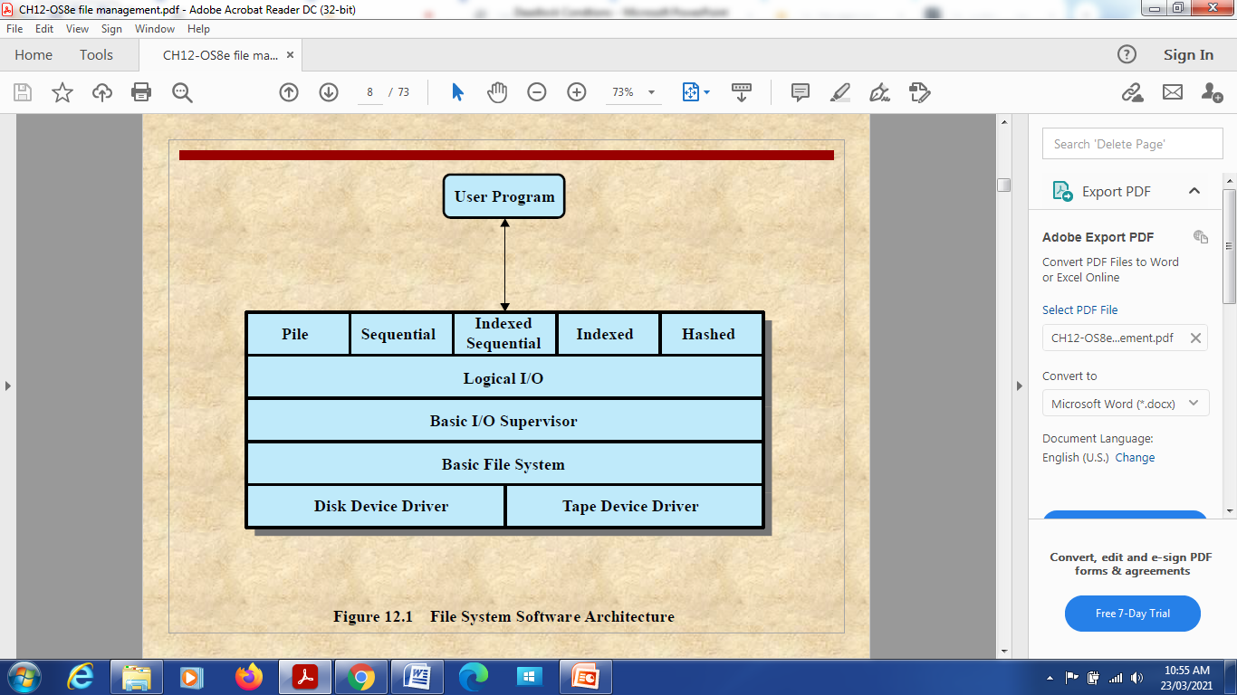
File system Software Architecture

Slide 136
Pile file contains a set of records in no particular order. The records are stored as they arrive. Location of a record in a pile file can be done by sequentially searching the records till the desired value of the key attribute is reached.

Slide 137
Device Drivers
Lowest level
Communicates directly with peripheral devices
Responsible for starting I/O operations on a device
Processes the completion of an I/O request
Considered to be part of the operating system

